Slide 1
IOT Based Garage Door Opener
Manpreet Kaur
C0757604
Group 4

Slide 2
Interfacing of LCD with Arduino UNO

Slide 3
Content:
Importance of this Interfacing
Arduino UNO : Features, Advantages, Pin Diagram
Introduction to LCD Module
I2C Backpack
Hardware Requirements
Software requirements
Code Explanation
Troubleshooting
Conclusion
References

Slide 4
Importance of this interfacing in our project
In our project we are using LCD Module to display a message to the user while the user wants to open the door manually. The LCD module will display message, for instance, Enter Your Password. The user will enter the password using keypad and thus the door will open. However, if the user enters the wrong password the LCD will display another message. This interface will allow the user to open the door manually in case the user does not have the access to their mobile phone. This interfacing make the project more diverse.

Slide 5
Arduino UNO : Introduction
Arduino Uno is a microcontroller board based on the ATmega328P. It is an open source electronics platform , easy o use hardware and software. It can be used to read inputs from sensors, finger on a button and even a message and it turns into an output. It has 14 digital input/output pins(of which 6 can be used as PWM outputs), 6 analog inputs, a 16 MHz ceramic resonator (CSTCE16MOV53-R0),a USB connection , a power jack, an ICSP header and a reset button. It contains everything needed to support the microcontroller, simply connect it to a computer with a USB cable to make it work. We are using Arduino Uno as a slave MCU to connect various other modules to our main MCU i.e BBB.

Slide 6
Arduino UNO : Features
The operating voltage is 5V
The input voltage will range from 7v to 12v
Digital Input Outputs pins are 14
Analog input output pins are 6
DC Current for each input/output pin is 40mA
DC currents for 3.3 v pin is 50 mA
Flash Memory is 32 KB
SRAM is 2 KB
EProm is 1 KB
CLK Speed is 16 MHZ

Slide 7
Arduino UNO : Advantages
Inexpensive: Arduino boards are relatively cheaper to other MCU’s. Therefore, it is budget friendly for those who are experimenting
Cross- Platform: The Arduino Software runs on Windows, Macintosh OSX and Linux operating software systems.
Simple, Clear programming environment: The Arduino software is ready to use for beginners, yet flexible for advanced users to take advantage of as well.
Open Source and extensible hardware: The plans of the Arduino board are published under a creative common license, so experienced circuit designers can make their own version of the module, extending it and improving it.

Slide 8
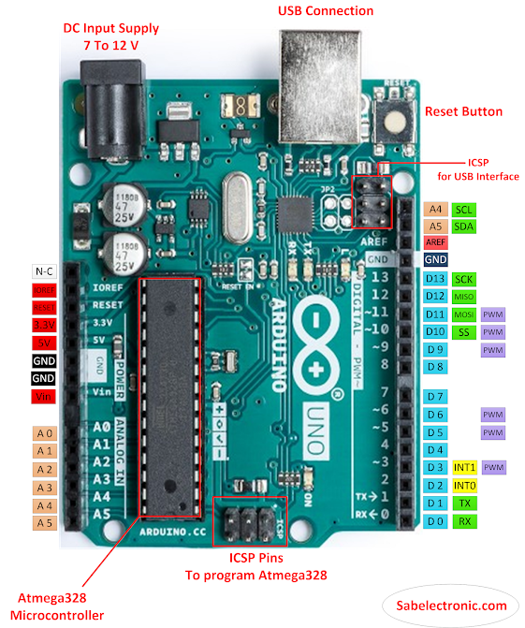
Arduino UNO : Pin Description

Slide 9
LCD Module : Introduction
A liquid crystal display (LCD) is a flat panel display, electronics visual display, or video display that uses the light modulating properties of liquid crystals. Liquid crystals do not emit light directly. In our project we are using 20*4 LCD display.

Slide 10
LCD Module : Pin Description
Pin No: | Pin Name | Parameters
Pin #1 | Vss | Ground Pin
Pin#2 | Vdd | Five volts/
Pin#3 | Vo | Used to set the contrast of the screen
Pin#4 | RS | Used to H/L register select signal
Pin #5 | R/W | Used to perform read and write
Pin#6 | E | Enable pin-
Pin #7-14 | DB0-DB7 | Data Bus for 4 bit or 8 bit mode.
Pin #15 | A(LED+) | Used to set the backlight anode
Pin#16 | K (LED -) | Used to set backlight cathode.

Slide 11
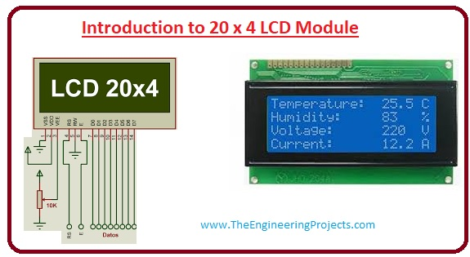
LCD Module : Pin Out Diagram
.

Slide 12
LCD Module : Advantages
Energy Efficient: LCDs are know for their energy efficient properties
Long lasting: Another advantage of lcds is their ability to last for a very long time
Inexpensive: lcds module for prototyping purposes or for small projects is really cheap
No Screen Burn In: The lcd use pixel made of organic material so they do not suffer from screen burning.

Slide 13
LCD Module : I2C Backpack
The I2C LCD backpack is a small PCB that can be soldered to the back of an LCD so that you may control it over an I2C bus. By using this product we can reduce the number of pins (Only two pins are needed for i2c) while still making it easy to interface with the LCDs.

Slide 14
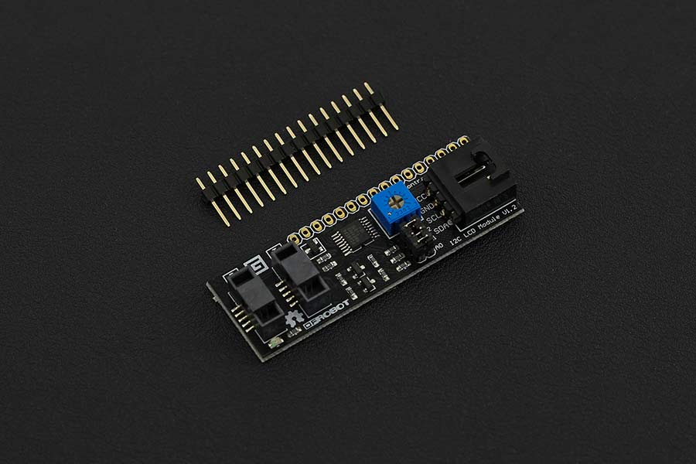
LCD Module : I2C Backpack

Slide 15
Hardware Requirements
Arduino Uno
LCD 20*4 module
I2c Backpack
Soldering kit
Jumper wires
USB Cable
Host Machine(Laptop)

Slide 16
Software Requirements
Arduino IDE
LCD I2C libraries
LCD.h Libraries

Slide 17
Interfacing : Connections
Vcc pin of lcd is connected to 5v of arduino
Ground pin of Lcd is connected to ground pin of arduino
SDA pin of lcd is connected to A4 and SCL to A5

Slide 18
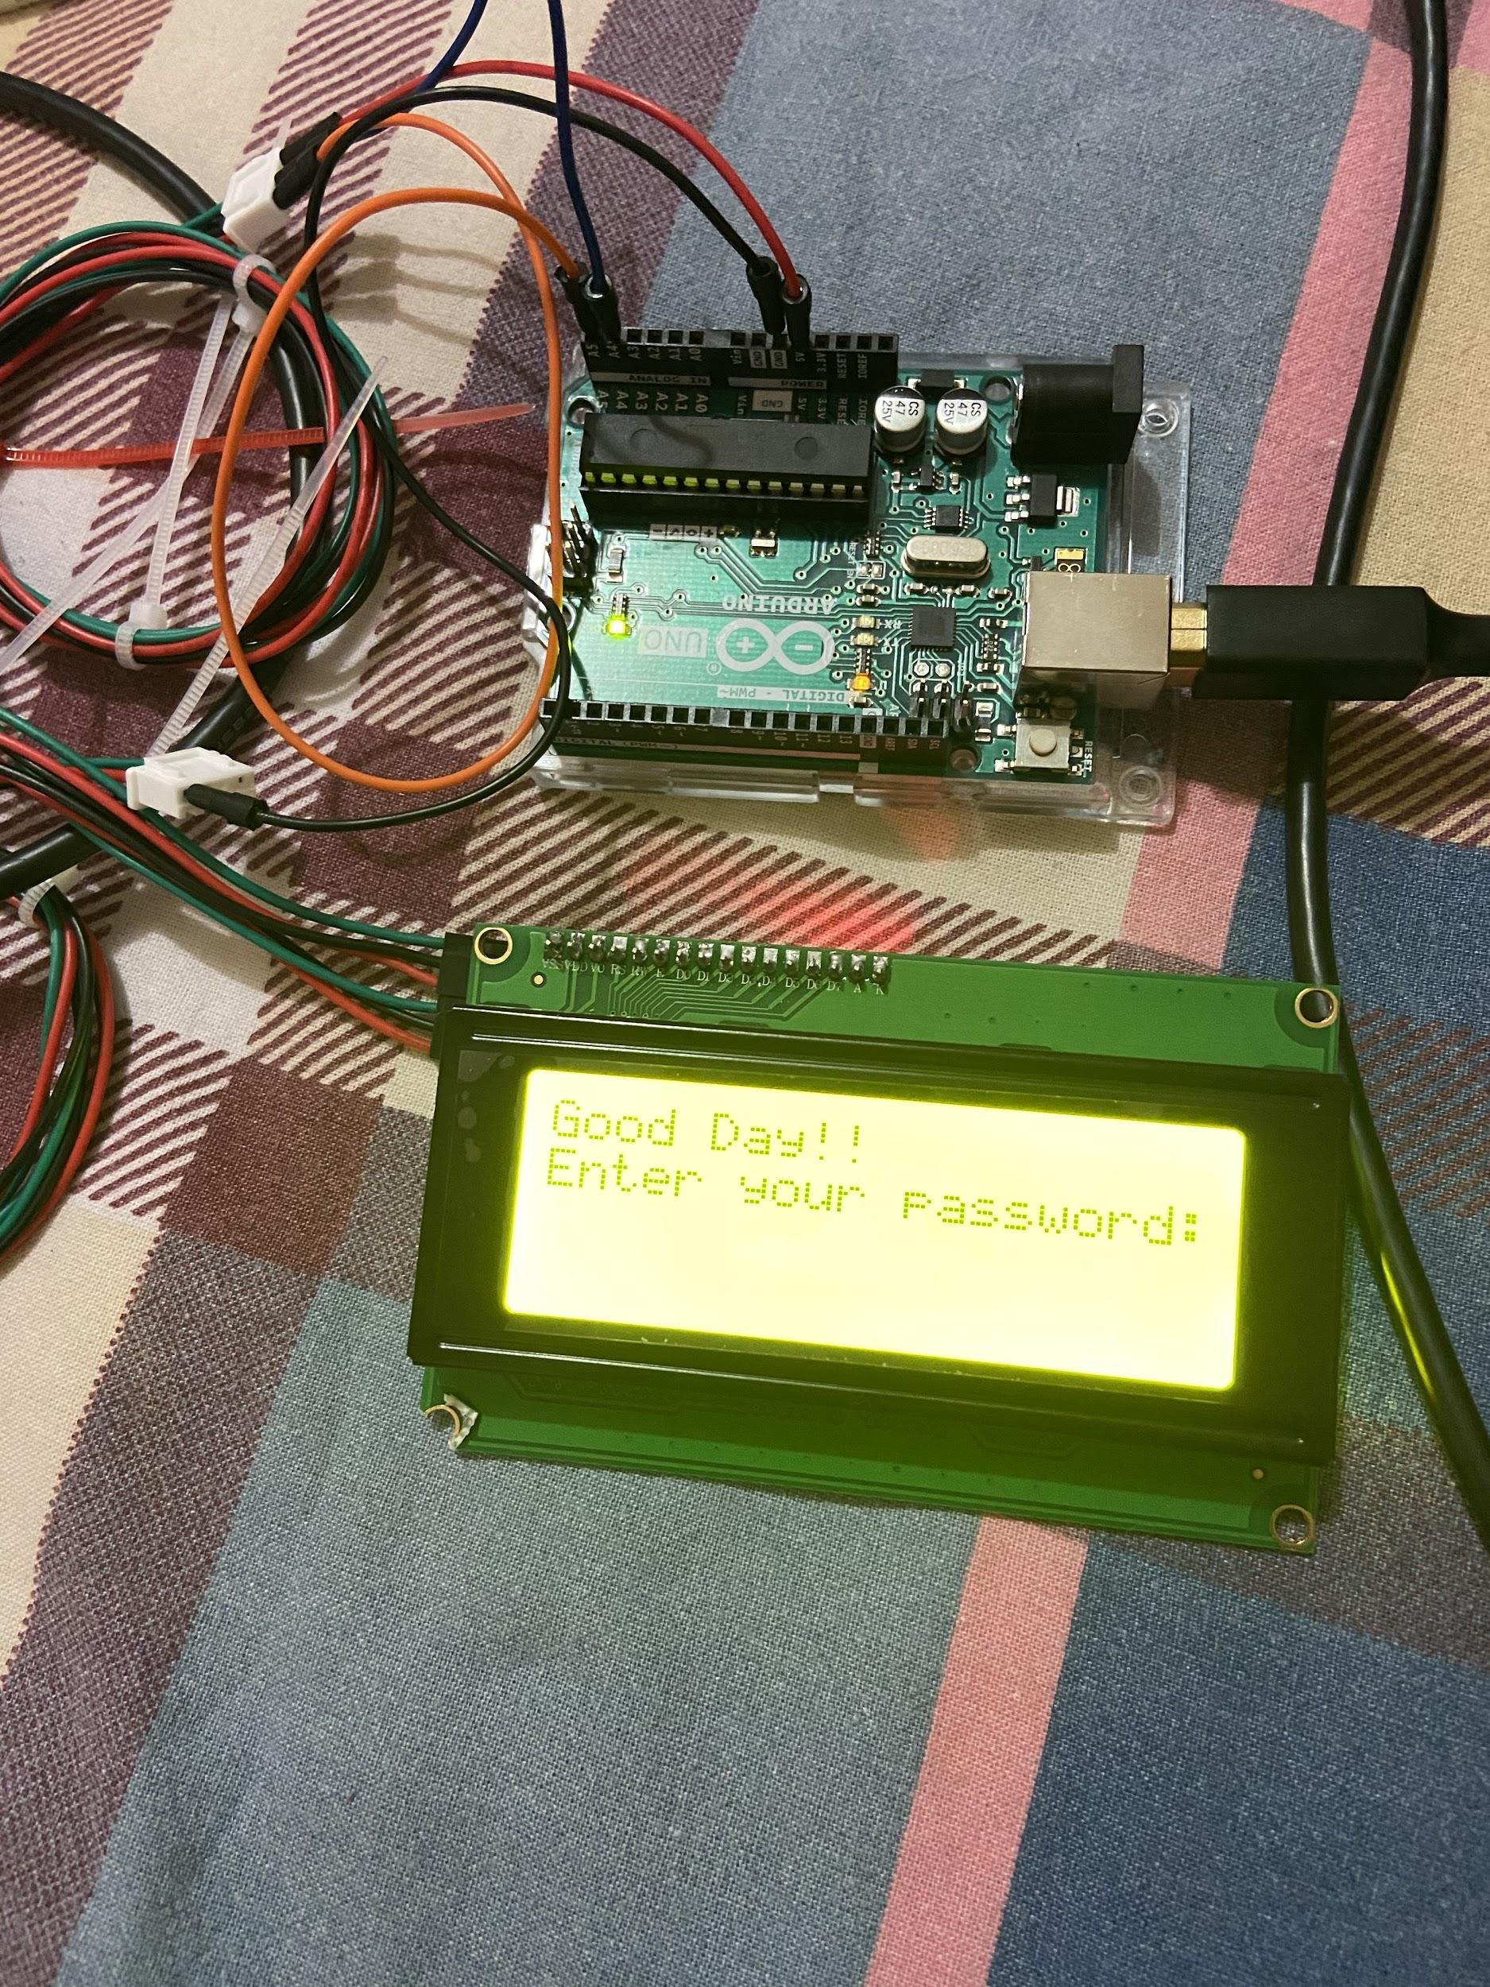
Interfacing : Hardware Connections

Slide 19
Code Explanation: Downloading Libraries
Open Arduino IDE
Then click on sketch
Then click include libraries > Manage libraries
Then click on manage libraries; library manager will open
Then type LCD libraries in the search box; then click install. The libraries will get installed.

Slide 20
Code Explanation: Coding
Including Libraries:
#include <LiquidCrystal_I2C.h> // Including libraries for LCD display
#include <LCD03.h> // Including libraries for LCD display
#include "Wire.h" // For I2C

Slide 21
Code Explanation: Coding
Setting Pins:
LiquidCrystal_I2C lcd(0x27,20, 4); // 0x27 is the default I2C bus address of the backpack

Slide 22
Code Explanation: Coding
Initializing the program:
void setup() // Initializes and sets the initial value
{
lcd.init(); // LCD initialization
lcd.begin (20,4); // 20 x 4 LCD module
lcd.setBacklight(HIGH); // to set the backlight
lcd.print("Good Day!!"); // print on LCD screen
lcd.setCursor(0,1); // to move to the next line
lcd.print("Enter your password:"); // print on LCD screen
}

Slide 23
Code Explanation: Coding
Void Loop:
Void Loop()
{
}
// the loop function does precisely what its name suggests and loops consecutively allowing your program to change and respond. We use to actively control the arduino board.

Slide 24
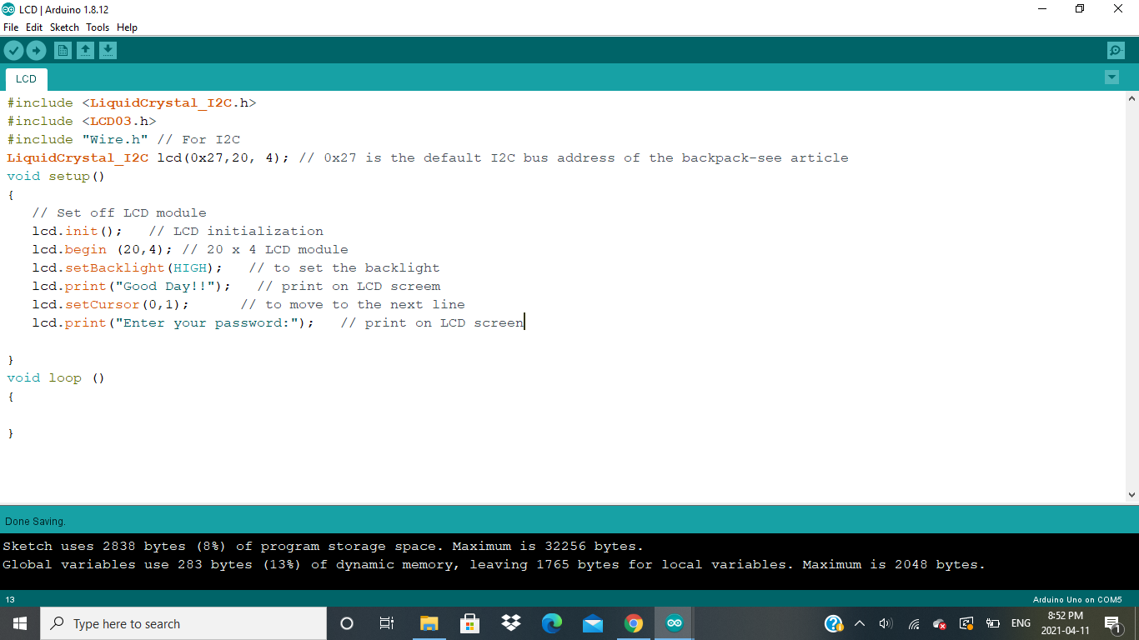
Code Explanation: Screen Shot

Slide 25
Troubleshooting
While compiling the program I was getting error of header files. The I searched and I realized that I have to add the libraries in the Arduino IDE which I have explained in the Previous slides. Finally , when I followed this procedure the program was working fine.
While running the program the output I was getting was in the same line , then I searched how can I display characters in two different lines. Syntax was: setCursor()
lcd.setCursor(col,row)

Slide 26
Conclusion
Finally, following all the steps mentioned in the previous slides I was able to complete my task of interfacing LCD display with Arduino Uno board successfully.

Slide 27
References;
For font size :Retrieved From Arduino cc., URL:
https://forum.arduino.cc/index.php?topic=341743.0
For cursor :Retrieved From Arduino cc., URL:
https://www.arduino.cc/en/Reference/LiquidCrystalSetCursor
For Void loop: Retrieved from Arduino.cc URL:
https://www.arduino.cc/reference/en/language/structure/sketch/loop/
For lcd display: Retrieved from Theengineeringprojects.com, Dec 2019 URL:
https://www.theengineeringprojects.com/2019/12/introduction-to-20-x-4-lcd-module.html
For I2C backpack : Retrieved from: dfrobot.com URL:
https://www.dfrobot.com/product-593.html#:~:text=The%20I2C%20LCD%20Backpack%20is,to%20interface%20with%20the%20LCDs.
For Code: Retrieved from: Createarduino.cc project URL:
https://create.arduino.cc/projecthub/akshayjoseph666/interface-i2c-16x2-lcd-with-arduino-uno-just-4-wires-273b24

